Slide 1


Remotes and Transitioning Code from OPS to DEV to OPS

Slide 2
Git Remote References
https://git-scm.com/docs/git-remote
https://git-scm.com/book/en/v2/Git-Basics-Working-with-Remotes
https://www.atlassian.com/git/tutorials/syncing

Slide 3
Steps
Create a Jira issue describing the problem and populate content appropriate to meet the sponsor’s requirements.
Create / initiate the “OPS” repository.
Remotes -> Copy the content of “OPS” into “DEV” assuming you want to have the latest OPS snapshot. Make a branch, update code, and commit changes referencing the Jira issue.
Merge your DEV/myBranch changes into DEV/master.
Remotes -> Reintegrate into OPS by connecting the OPS repo to the DEV/master using a remote hook.
Create a new branch in OPS, merge /remotes/DEV/master into the OPS branch. If everything passes merge your OPS/branch into OPS/master.

Slide 4

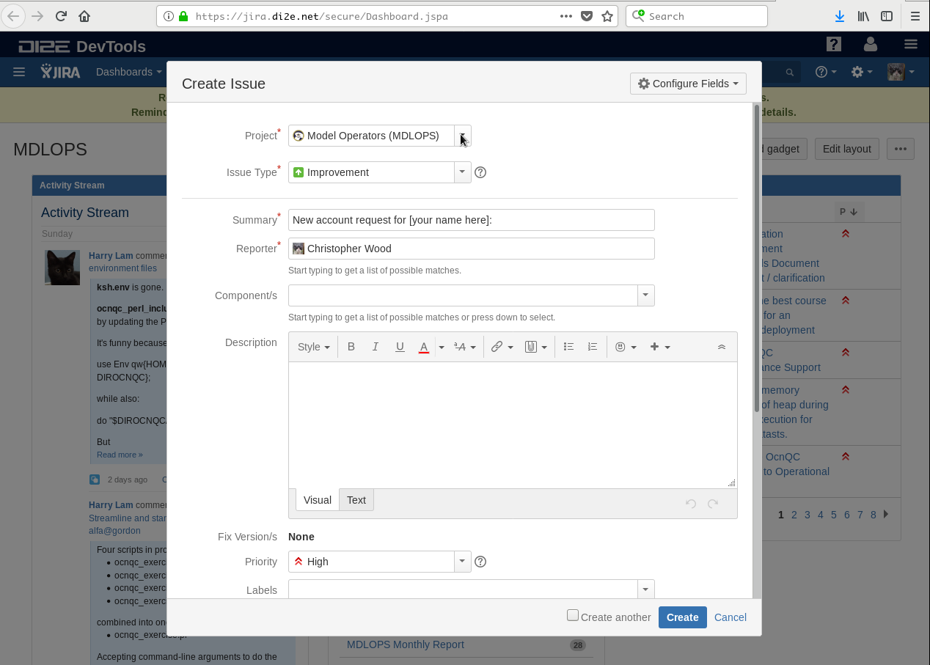
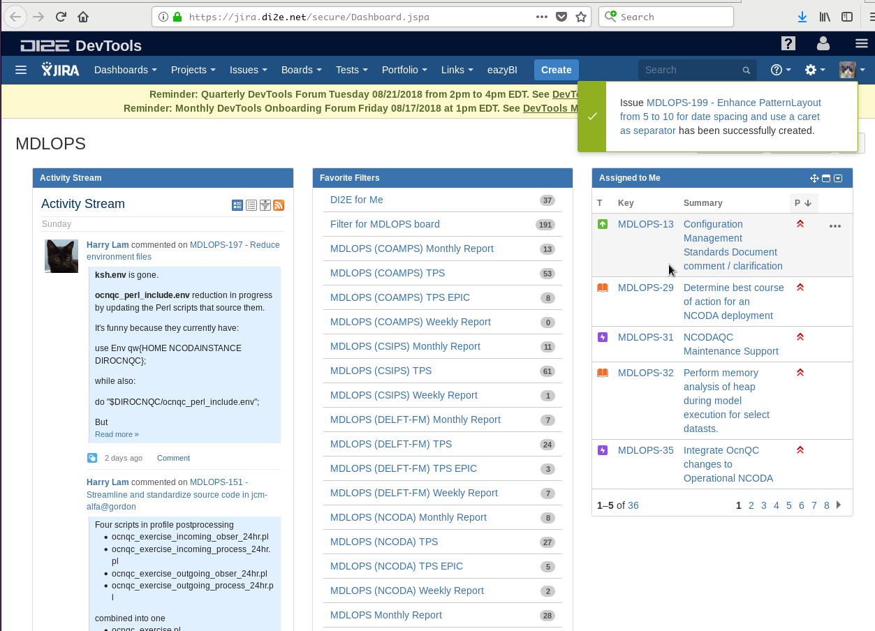
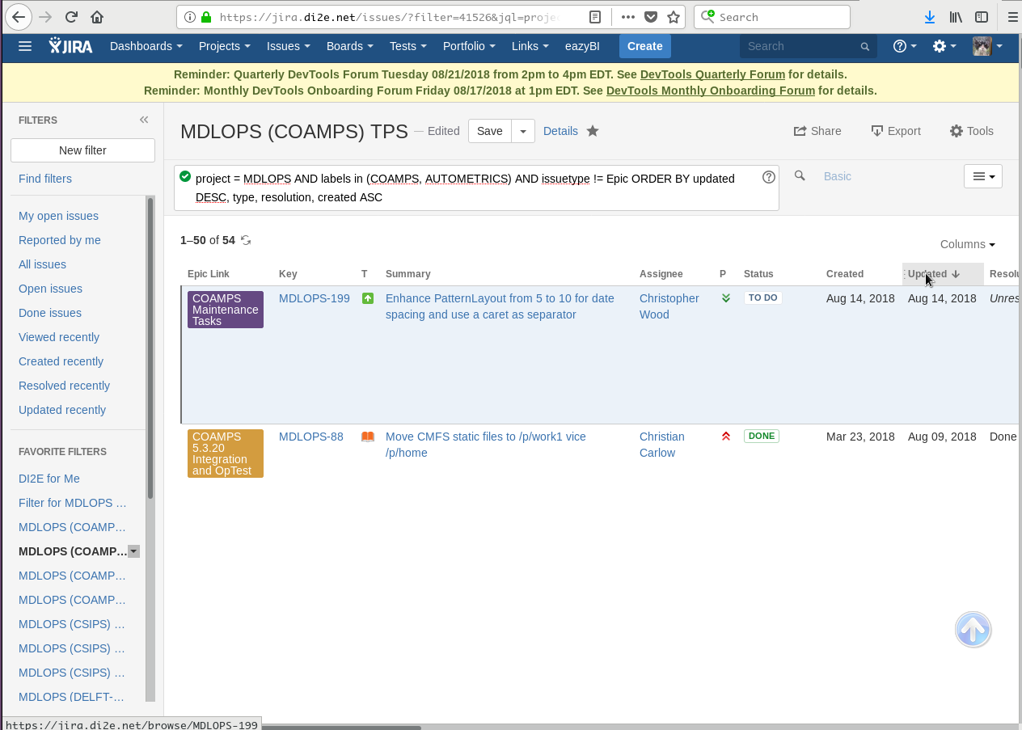
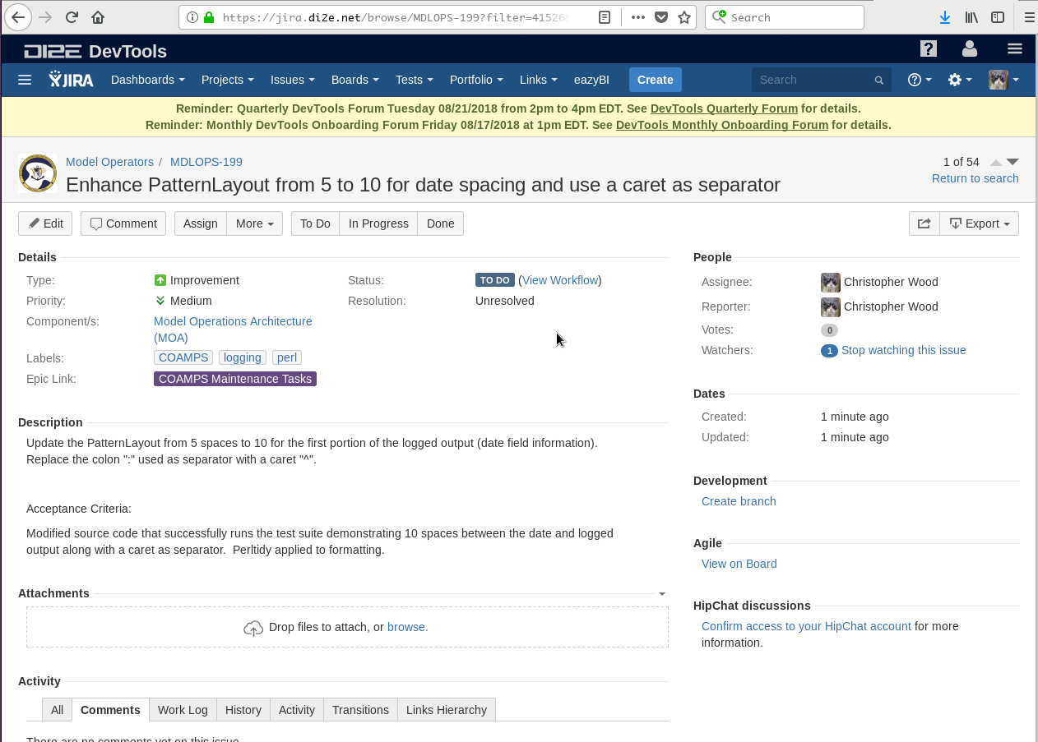
Jira Issue ~ software change accountability

Slide 5
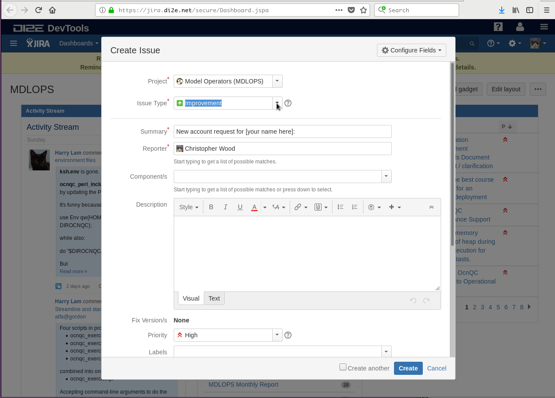
Jira Issue ~ populate meta-data
Project -> Model Operators (MDLOPS)
Issue Type -> Select what works for your task
Epic ~ large scale efforts that involve multiple sub-tasks
Bug ~ verifiable requirements failure with the software
Improvement ~ An improvement to an existing requirement
User Story ~ Generic story type for any work performed
New Feature ~ New requirements added to an established application
Task ~ Action Items and shorter duration tasks that you don’t want to lose track of

Slide 6
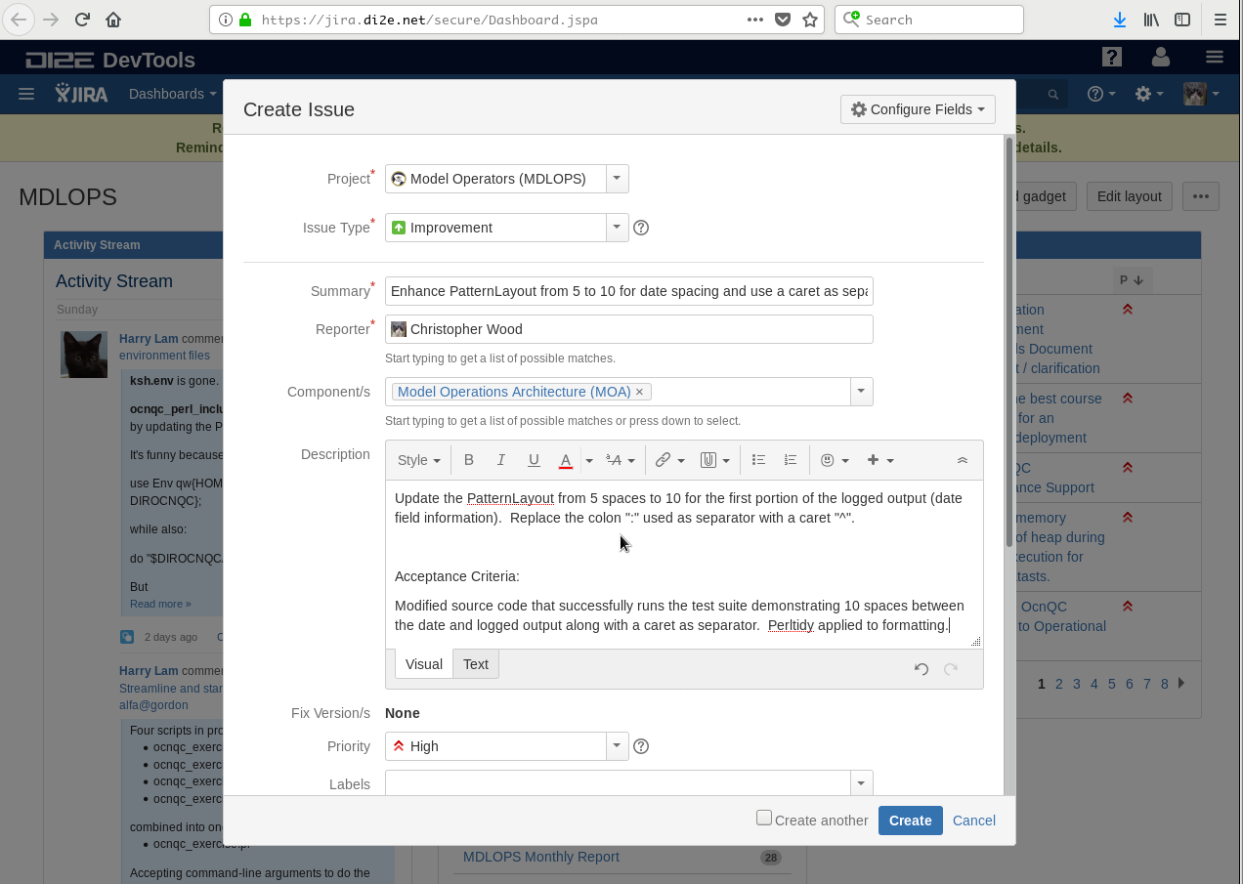
Jira Issue ~ populate meta-data
Summary – be terse but descriptive enough to find the work.
Components – used to break major efforts out into discrete pieces, thus far: Model Operations Architecture (MOA), CSIPS, COAMPS, NCODA.
Description – highly flexible editor that supports advanced formatting. Should contain the description of the issue and acceptance criteria by which completion is measured.

Slide 7
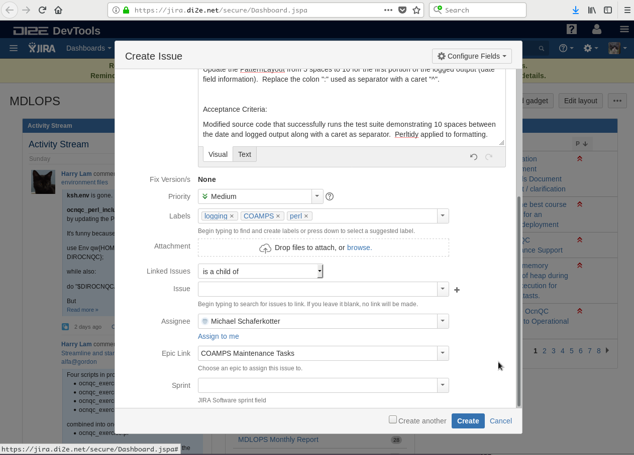
Jira Issue ~ populate meta-data
Priority – should be discussed with sponsor.
Labels – think of this as tagging your issue to help facilitate searching for content. Currently used to track issues across contracts using domain values of: AutoMetrics, COAMPS, CSIPS, NCODA, DELFT-FM as well as other tags related to issue description.
Attachments – don’t make the mistake of assuming this is a place to CM documents. IT IS NOT. Used Attachments to store transient content or data related to the specific task whose purpose wans as the task nears completion.
Issue – allows you to create links between issues such as parent / child, or blocks, etc..
Assignee – the registered DI2E user that will work the issue.
Epic Link – allows you to link issues under a broader issue thus creating a simplistic hierarchy of related issues.

Slide 8
Jira Issue ~ submit your issue
Newly created issues – appear as pop-ups, for a short duration, after creating them. Select to see more details about the issue or use Jira Query Language (JQL) to find an issue.

Slide 9
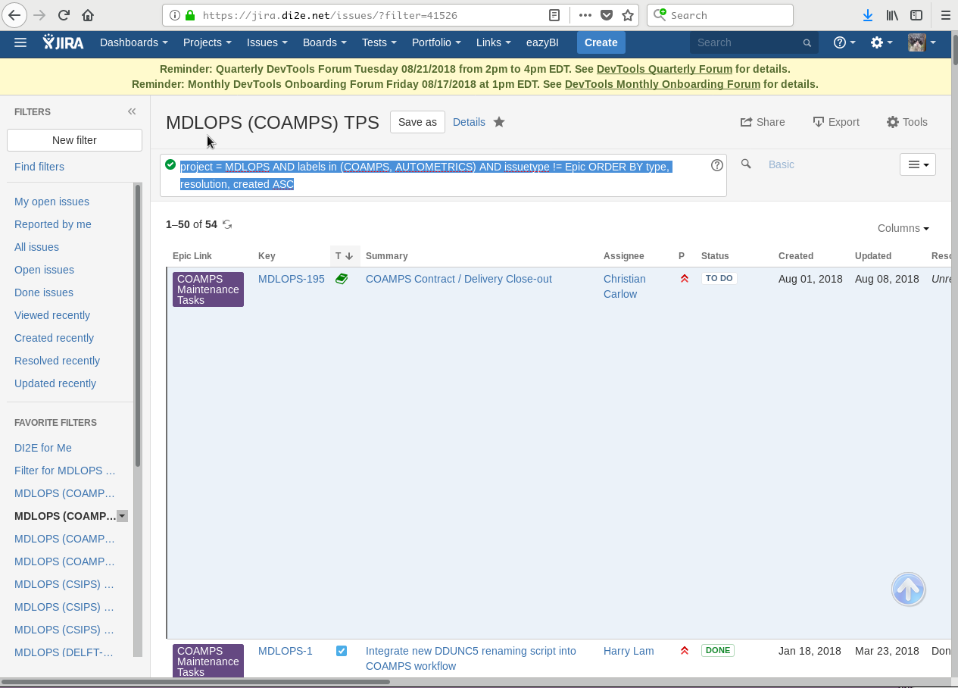
Jira Issue ~ find the issue
JQL – Jira Query Language is Structured Query Language (SQL) like and has an interactive / free-form searching tool.
Filters – JQL created by yourself or published by others used to help find discrete issues.
Attachments – Customizable data-table allows for column re-org, sorting, column selection, and export options ranging from MS-Excel to CSV.

Slide 10
Jira Issue ~ find your issue
Reverse Updated– your newly created issue will appear in the listing.
Select Hyperlink – to view your issue and manipulate it further.

Slide 11
Jira Issue ~ view / edit your issue
Top Buttons– Support macro level functions, detailed edits, and workflow.
Meta-data– it embedded within page and each field is discretely editable on the fly.
Supplemental details– are available along the far right hand side..

Slide 12
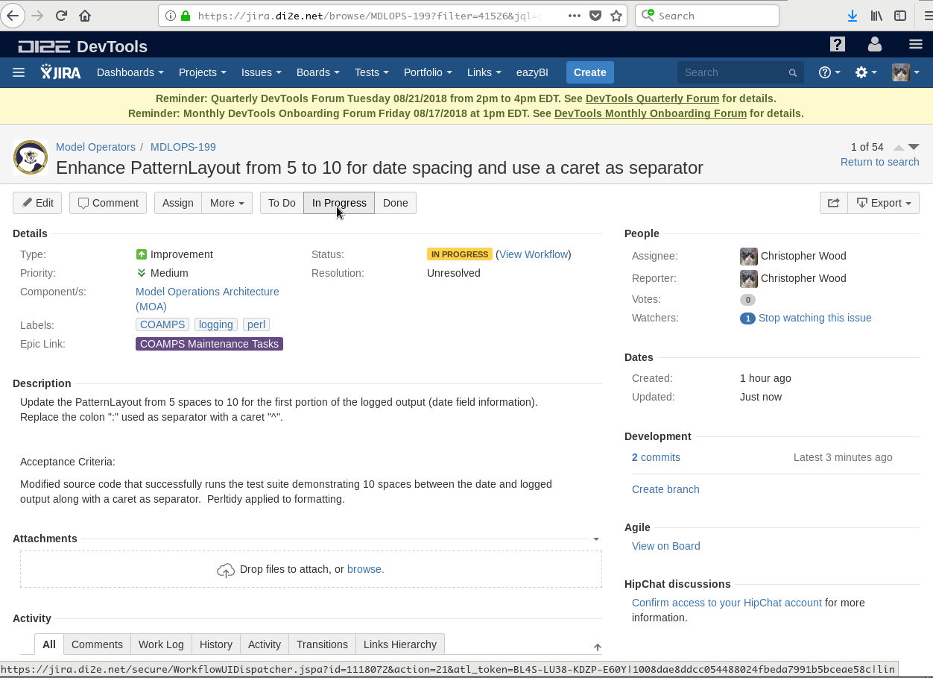
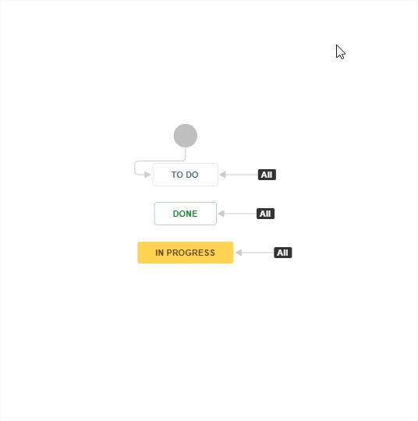
Jira Issue ~ workflow
Top Buttons– Use top buttons to help migrate your task through each phase of the Jira workflow (configurable).
Visual Progress– shown on demand

Slide 13

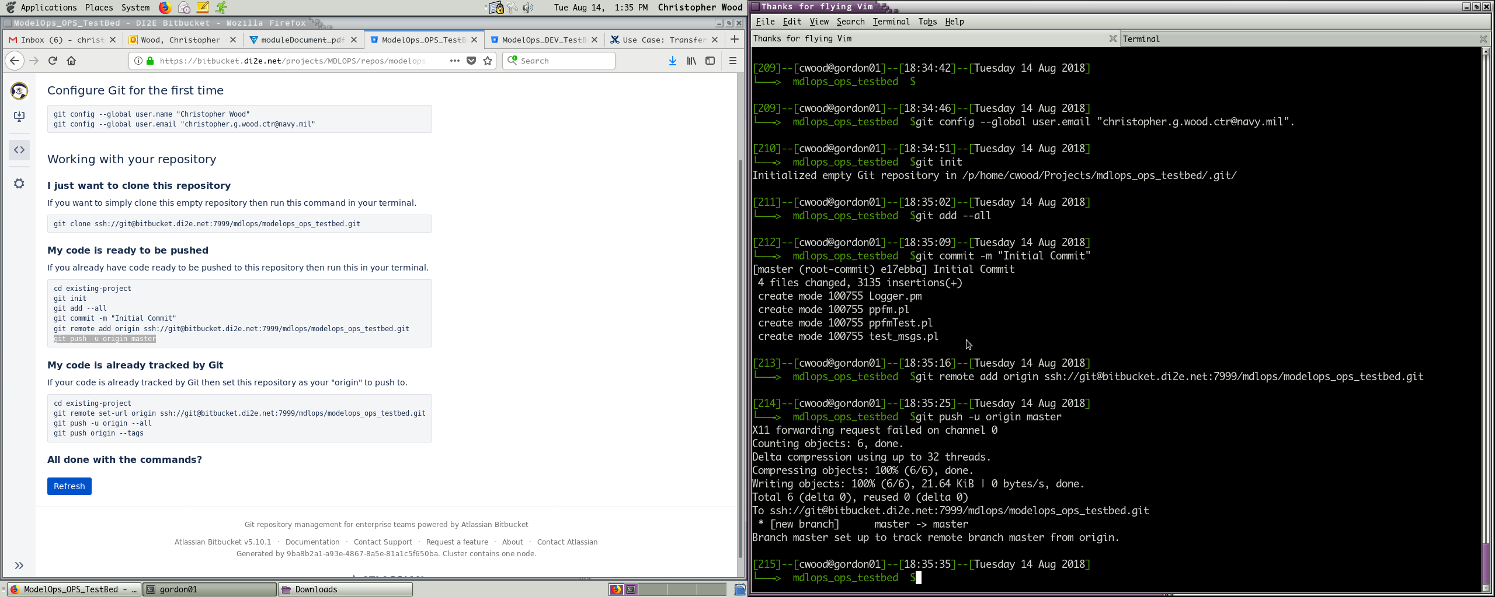
OPS Repository – Have one…

Slide 14
OPS Repository – Have one…
Bitbucket– Web wrapper for a Git repository with a lot of nice and convenient features baked in.

Slide 15
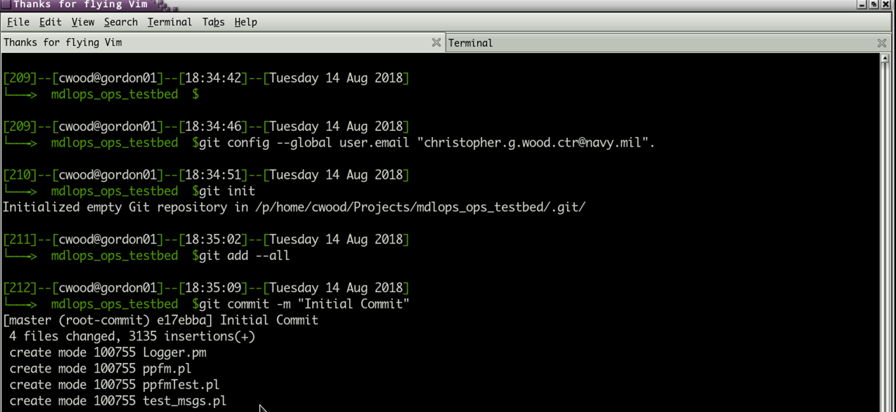
OPS Repository

Slide 16
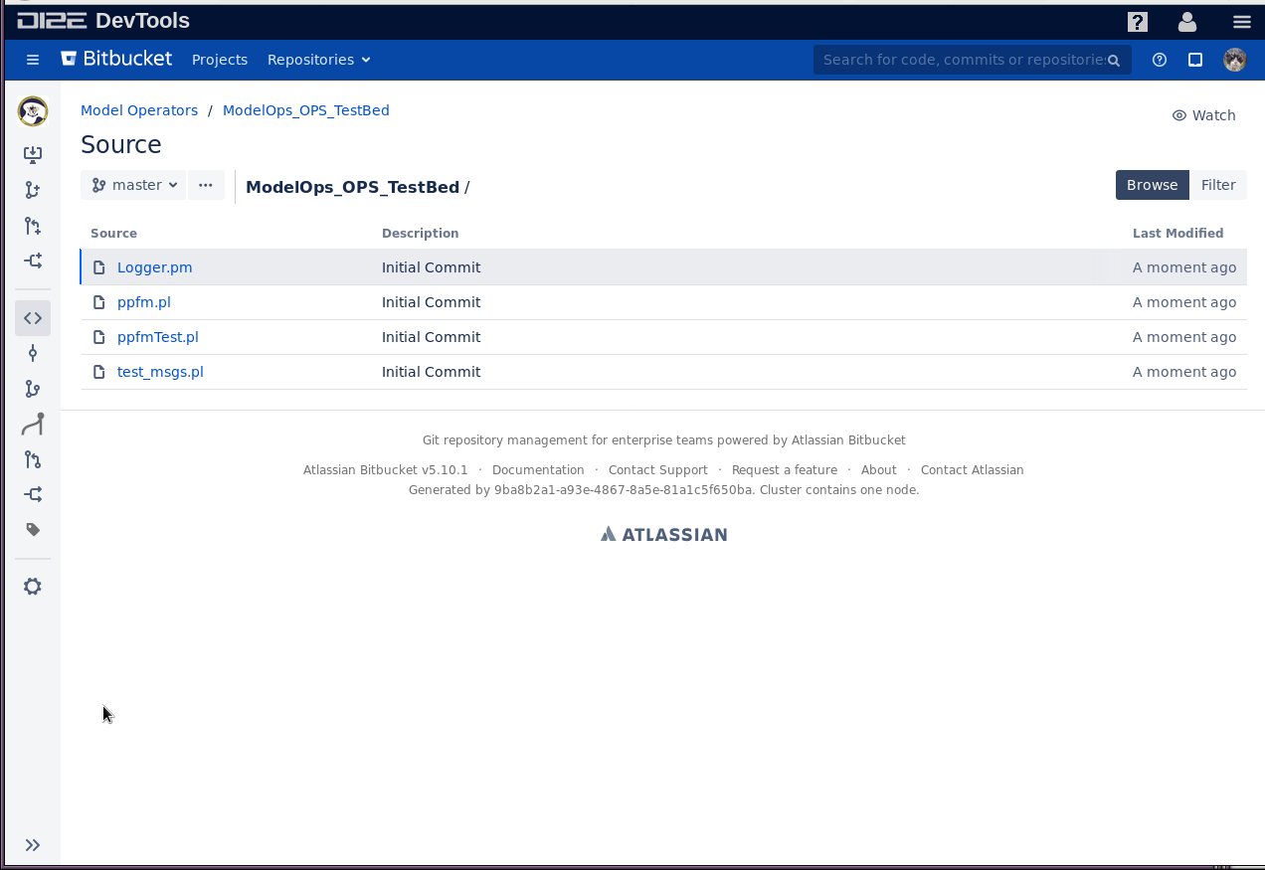

Slide 17

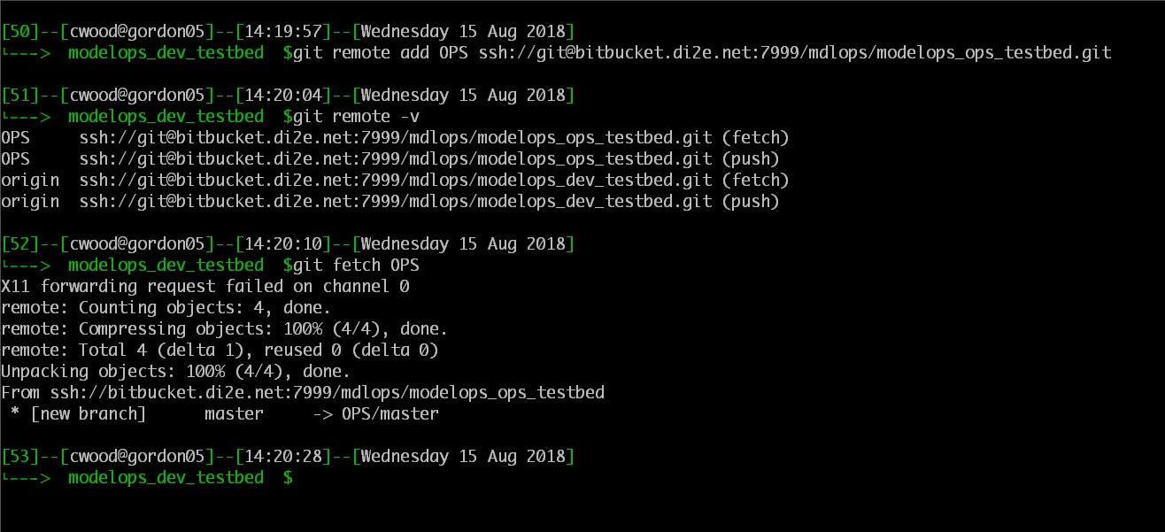
Copy OPS to DEV, that way you always start from what’s on the execution environment
#add a remote
git remote add upstream <URI>
#copy down remote locally
git fetch upstream
Add a remote.
Copy down a copy of the remote.

Slide 18
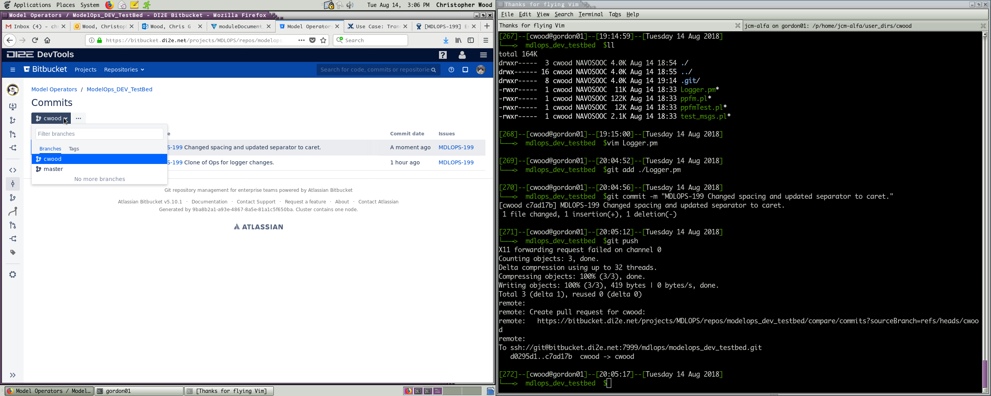
Create a branch, make your change, and commit referencing Jira Id with specific syntax
#change content
vim Logger.pm
#test…
#add the change to the git repo
git add Logger.pm
# commit the change with comments
git commit –m “MDLOPS-??? Msg”
#push an actual repository
#origin points to Bitbucket
git push origin
Commit syntax is specific but easy.

Slide 19
Once pushed your branch shows in the Bitbucket repository.

Slide 20
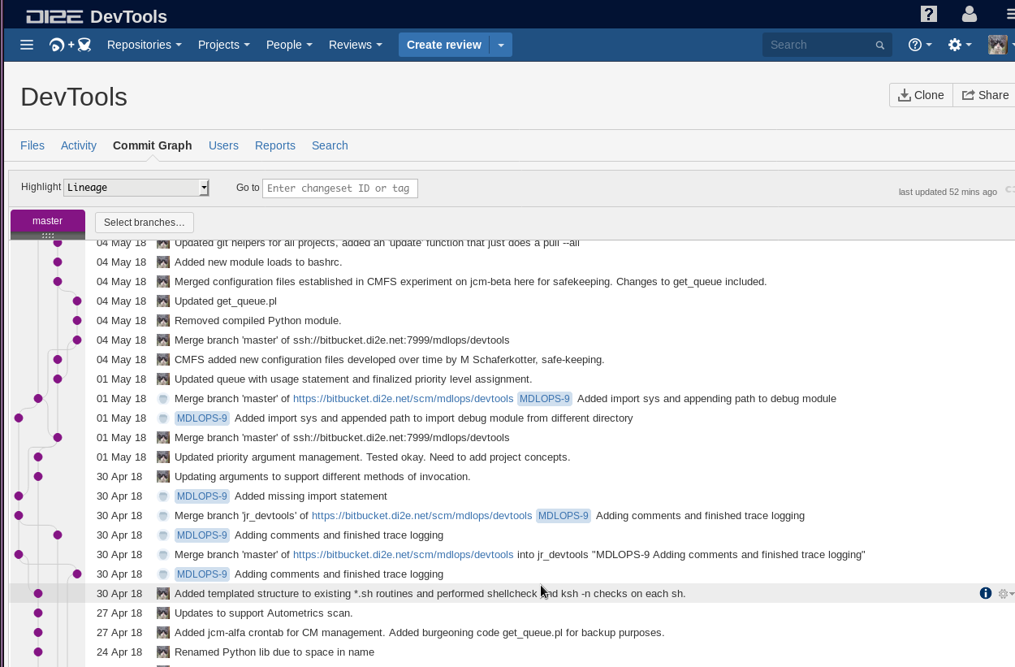
Using Fisheye you can “see” branches break-out and then merge back in

Slide 21

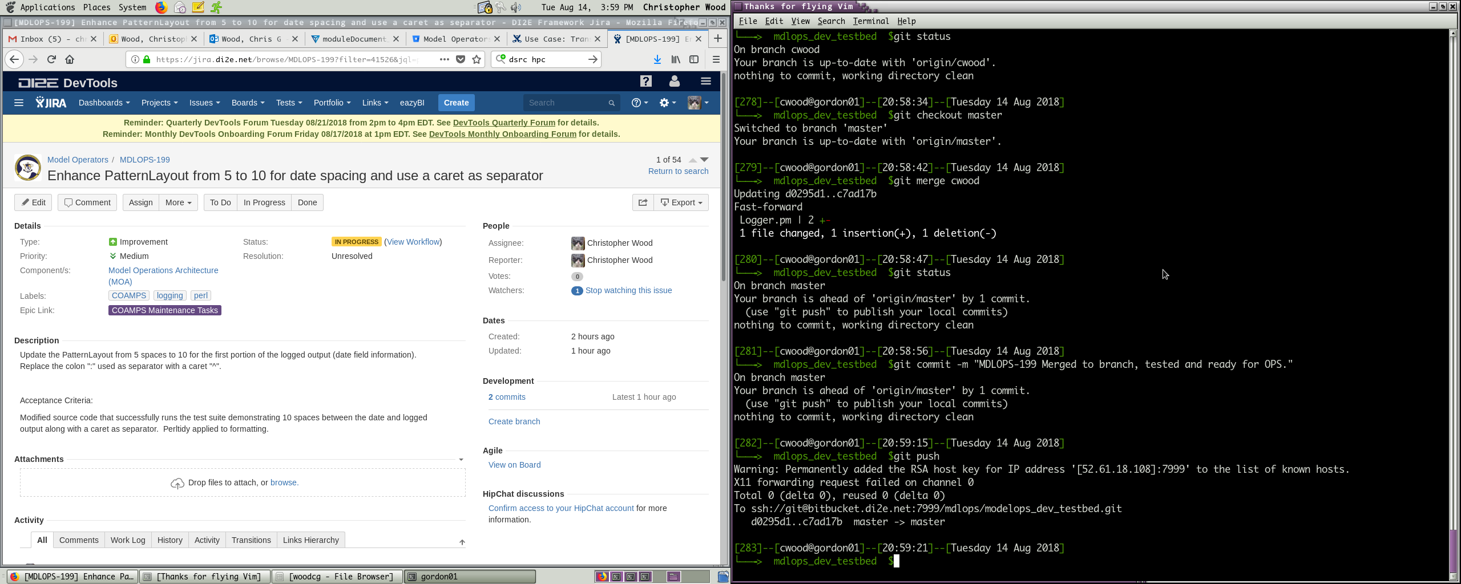
Merge your branch into the DEV/master
#Change back to the master
git checkout master
#Merge your branch (myBranch) with the master
git merge myBranch
#Commit your changes
git commit –m “MDLOPS-??? Msg”
#Don’t forget to push
git push origin
Change to master.
Merge branch into master.
Push.

Slide 22

Merge your branch into the DEV/master
Each referenced Jira issue on the Git commit is referenced in ticket.
Change to master.
Merge branch into master.
Push.

Slide 23

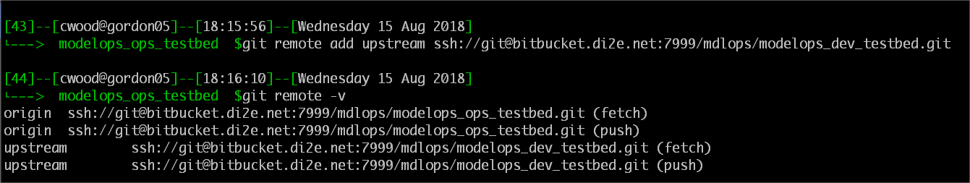
Remote hook from OPS to DEV/master
#connect OPS to DEV
%git remote add upstream <dev_repo>
#show remote connections
% git remote –v

Slide 24
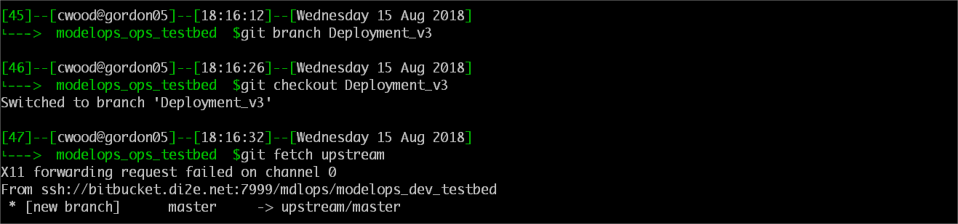
Remote hook from OPS to DEV/master
#make a branch to receive the DEV changes
% git branch Deployment_v3
#Copy down the changes locally without merging yet
% git fetch upstream

Slide 25
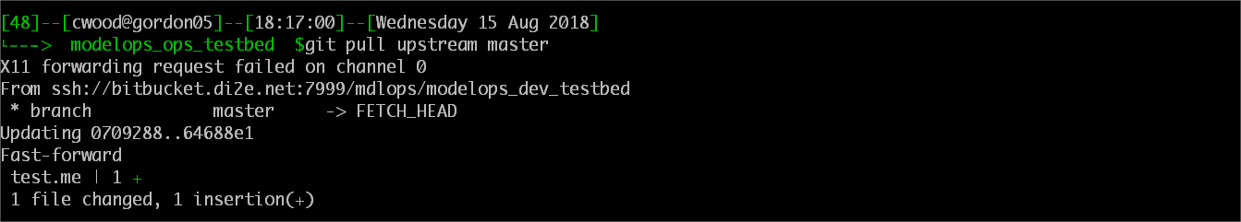
Remote hook from OPS to DEV/master
#Test functionality.
#Pull and merge from <dev_repo> master
% git pull upstream master

Slide 26
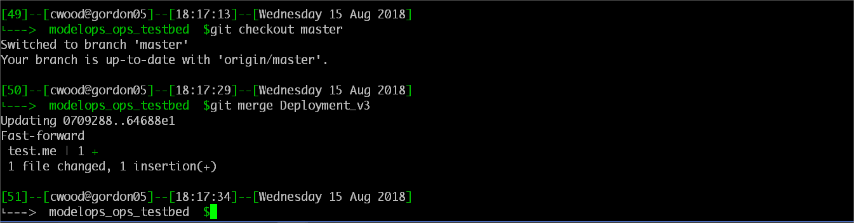
Remote hook from OPS to DEV/master
#Test functionality.
% git checkout master
#Change to OPS master
% git merge Deployment_v3
#Merge as new OPS capability
#Tag

